Slide 1
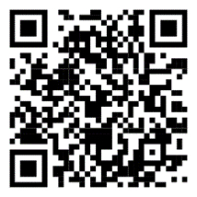
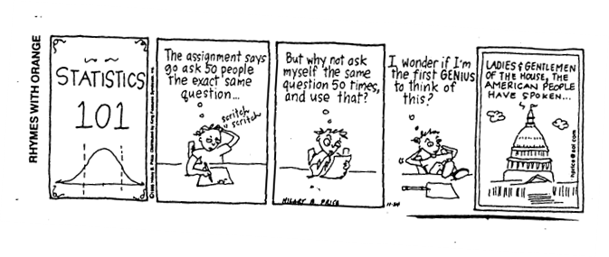
Stat 414 – Day 6
Fixed vs. Random effects

Slide 2
Project Assignment
Step 1: Find multilevel data (hierarchical or nested structure)
Subjects within organization
Students/classroom, employees/supervisor
Repeated measures within subjects
Cluster sampling, Cluster randomized trials
Survey respondents within country

Slide 3
Some cool facts
$R^{2}=corr\left(y, \hat{y}\right)=1−\frac{SSError}{SSTotal}$
$R_{adj}^{2}=1 −\frac{MSError}{MSTotal}$

Slide 4
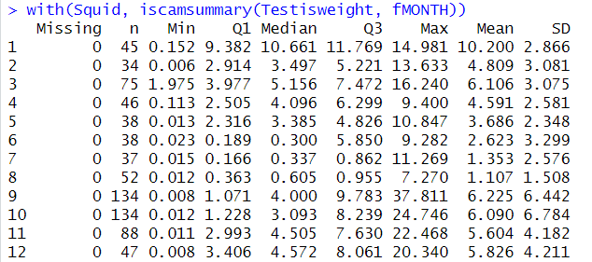
HW 2
Raw data vs. Model estimates

Slide 5
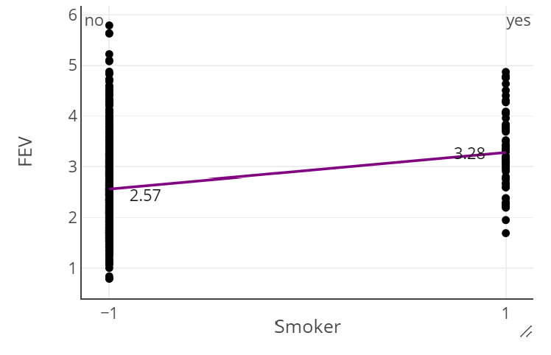
FEV data
Effect or Indicator coding?
Is 2.92 = $\overline{y}?$
“least squares mean”
If 0.71 the difference in the two group means?
Make sure comparison is clear in your interpretation (e.g., vs. overall mean vs. reference group)

Slide 6
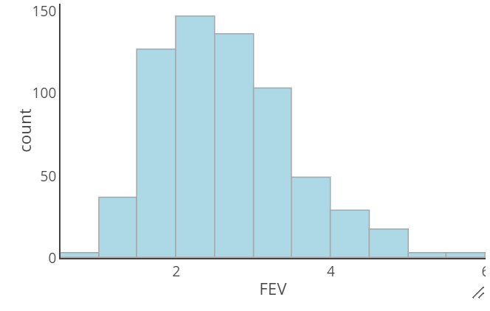
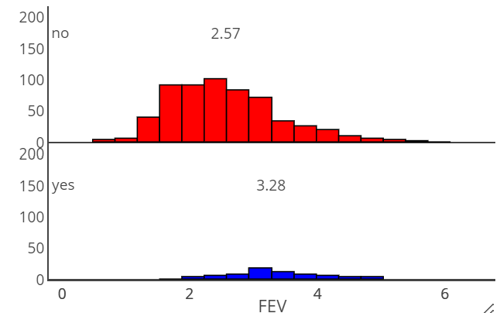
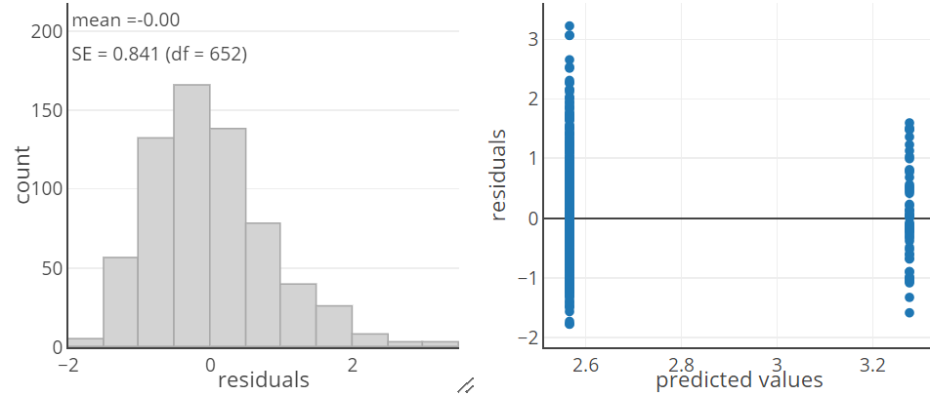
FEV data
Model 1 residual/diagnostic analysis

Slide 7
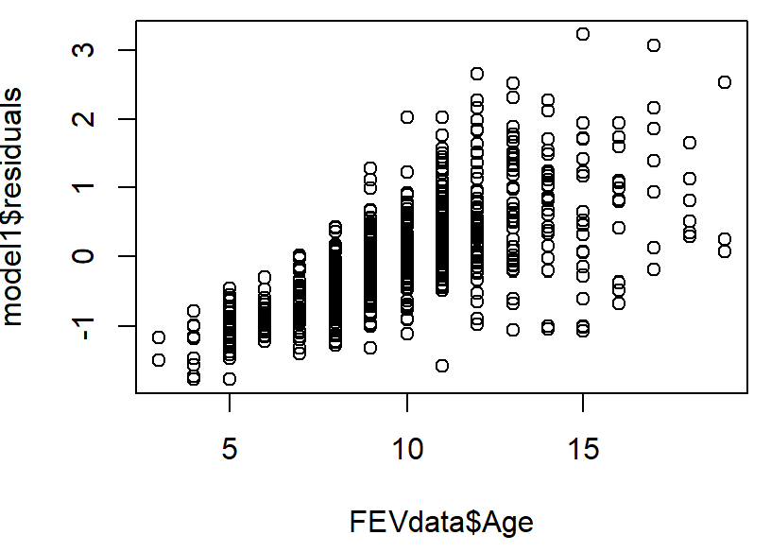
FEV data
Often helpful to explore whether residuals are related to other variables not currently in the model

Slide 8
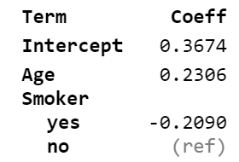
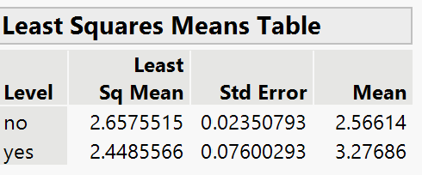
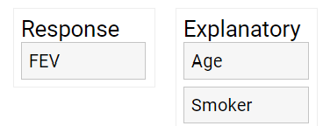
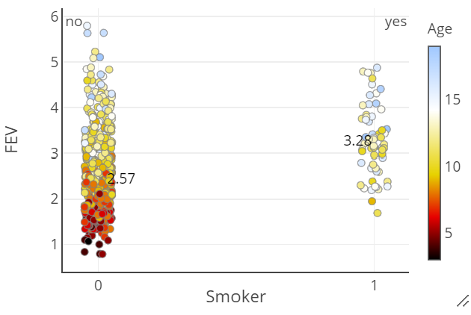
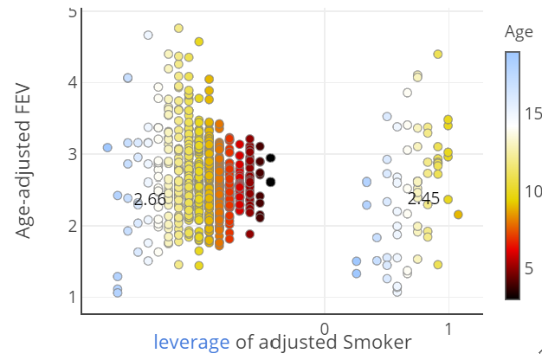
Added variable plots
A visual representation of the adjusted association

Slide 9
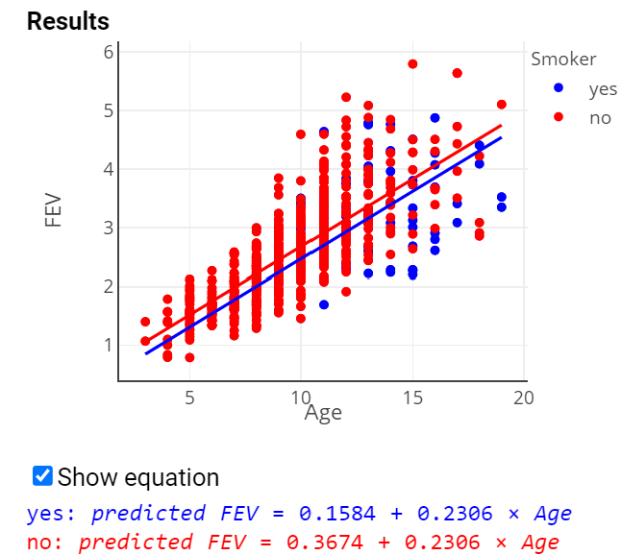
FEV data
After adjusting for age
Better: comparing avg FEV of smokers and non-smokers of the same age
Have made a HUGE assumption here…
The difference in avg FEV between smokers and non smokers is the same at each age….

Slide 10
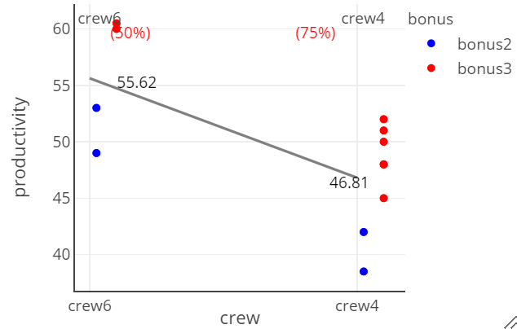
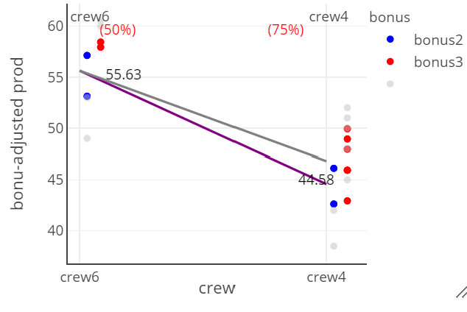
Example (workcrew3.txt)
Suppose I want to study the “effect” of crew size and bonus amount on crew productivity
What happens if I “adjust” for bonus?

Slide 11
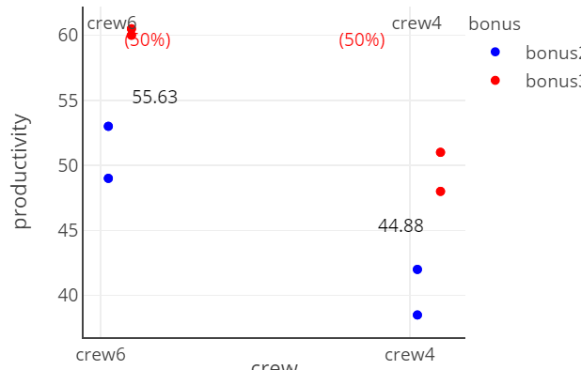
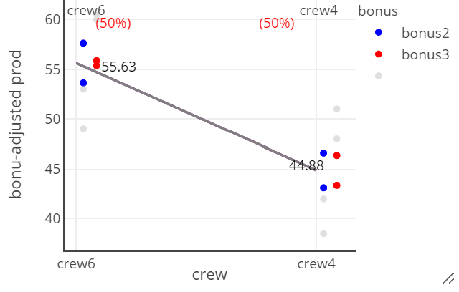
Example (workcrew1.txt)
Suppose I want to study the “effect” of crew size and bonus amount on crew productivity
What happens if I “adjust” for bonus?

Slide 12
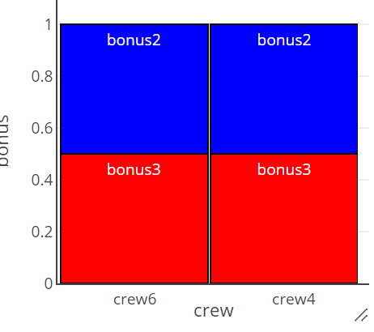
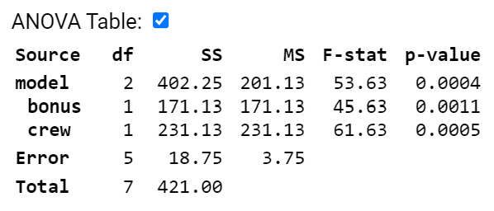
In other words
If x₁ and x₂ are not related, then adding x₂ to the model will not change the coefficient of x₁
Might be true for a controlled experiment, but seldom true for an observational study

Slide 13
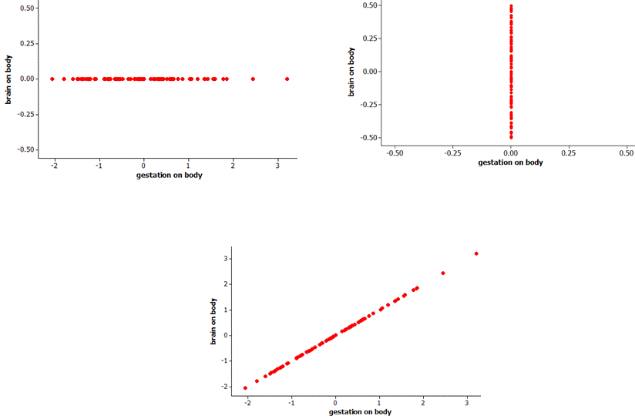
What does each graph tell you?
Added variable plots

Slide 14
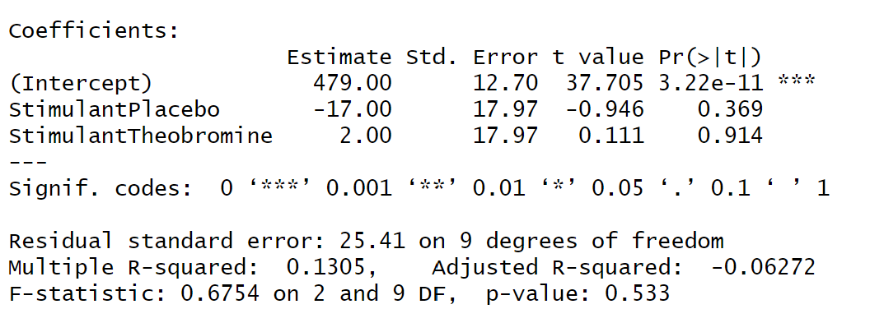
Finger tapping study
One-way ANOVA can help us see whether there is a significant difference among the 3 types of stimulants
But doesn’t account for the person to person variation

Slide 15
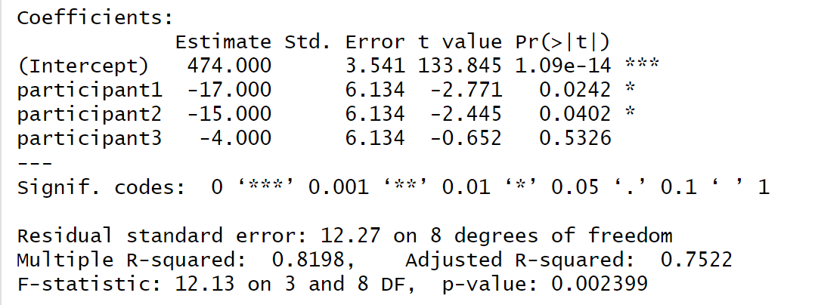
Finger tapping study
Does participant matter?
ICC = (1826 – 150.5)/(1826+150.5*2) = .788

Slide 16
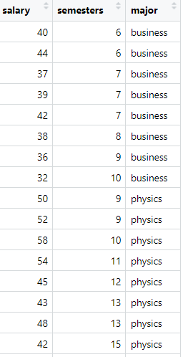
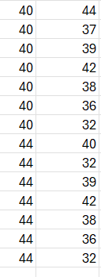
“Pairwise ICC”
r = .670
How correlated are pairs of observations within each major…

Slide 17
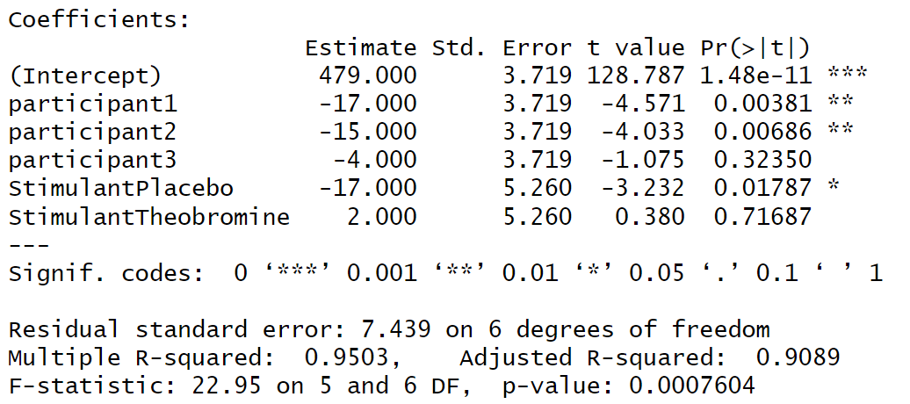
Finger tapping study
So add the participant into the model
Reminder to always be clear which p-value you are using!

Slide 18
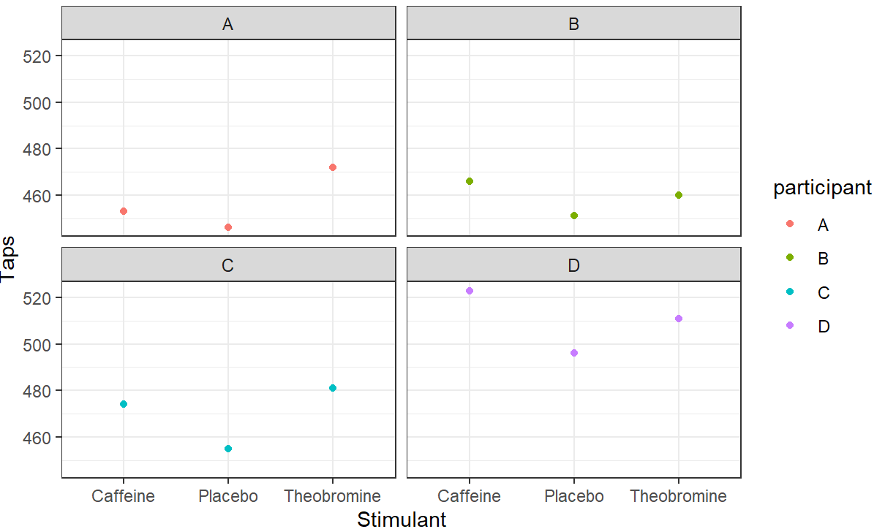
Finger tapping study

Slide 19
Next question
Suppose we had a larger study with lots more participants. What would be a downside to including the participant variable in the model?

Slide 20
Fixed vs. Random
When you have multilevel data, Level 1 units are clustered within Level 2 units. I can consider the “level 2 grouping variable” as a categorical variable.
With categorical variables, we have the option of treating them as fixed vs. random
Fixed: Only want to make conclusions about the specific levels we have observed (e.g., Race/Ethnicity)
Random: The observed outcomes (e.g., school ID) is not really important to me, I’m thinking of the schools as a random sample of a larger population and want to make inferences about all schools, not just those in my study

Slide 21
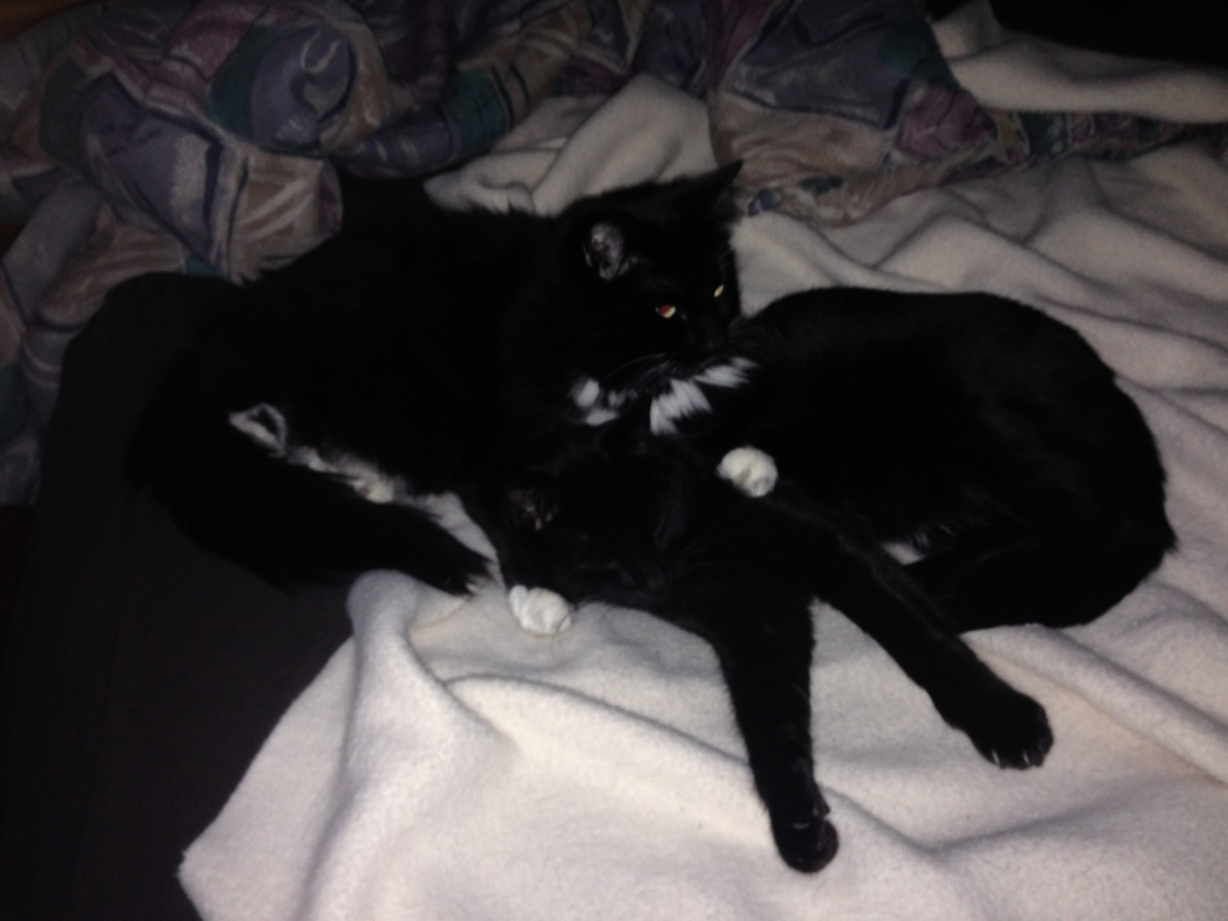
Fixed vs. Random Effects
Groups are unique entities and want to make inferences about (only) those groups
Analogy: Which one?
Groups are regarded as a sample from a population and want to make inference about that population
Group sizes are small (avoid overfitting)
Group effects not normally distributed
Fixed
Random
Random
?

Slide 22
To Do
Submit HW 3 (Fri night)
Quiz 6 (Fri 7am)
Willing to consider later
Computer problem 6 (Monday night)
Project proposals (Monday night)
(Thurs am office hour in zoom)

